Slide 1

Guardrails in LLMs: Ensuring Safe and Controlled AI Responses
How Do Guardrails Work? Understanding Their Role in Filtering, Restricting, and Guiding AI Behavior

Slide 2
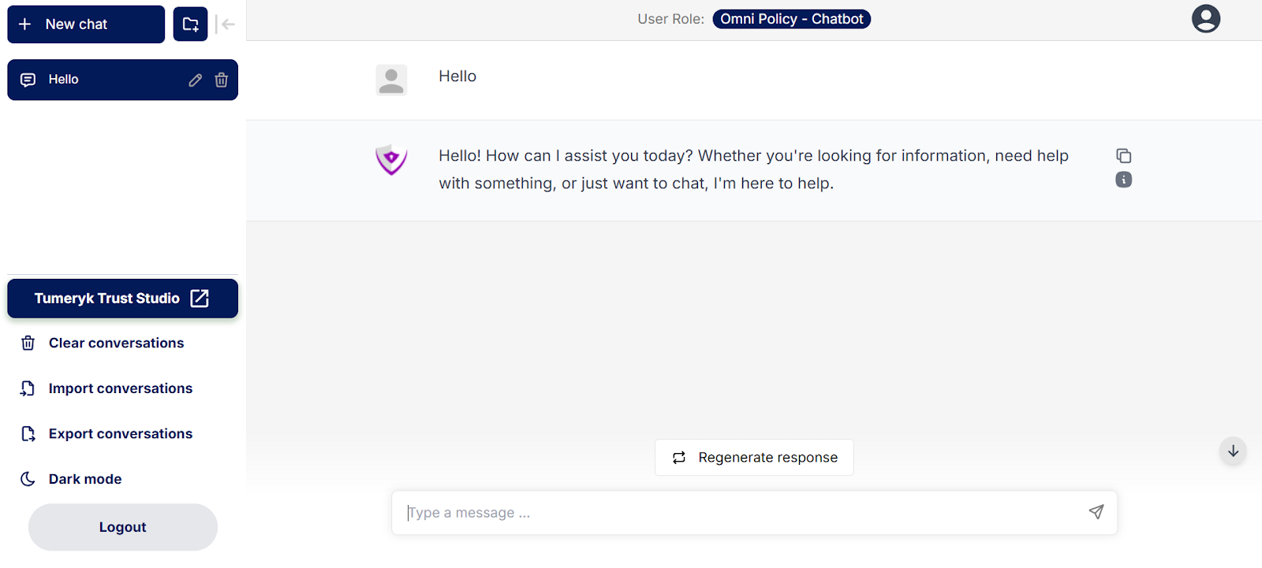
-Here, The user initiates the chat with "Hello", and the chatbot responds with a greeting, offering assistance. - If you want to access a chatbot for free, refer: Tumeryk chatbot
Getting Started with LLM Chatbot

Slide 3




LLM Chatbot Response Behavior
The chatbot responds to all user inputs, even when it should ideally refuse or ignore certain prompts.
This happens because LLMs are designed to generate responses based on patterns in training data rather than strict control mechanisms.
Key Issue: Without proper safeguards, the chatbot might provide responses that should be restricted, including:
Sensitive or confidential topics
Misinformation or biased content
Unintended responses due to prompt manipulation
This highlights a vulnerability in LLM chatbots where they lack built-in refusal mechanisms unless explicitly programmed with strong guardrails.

Slide 4
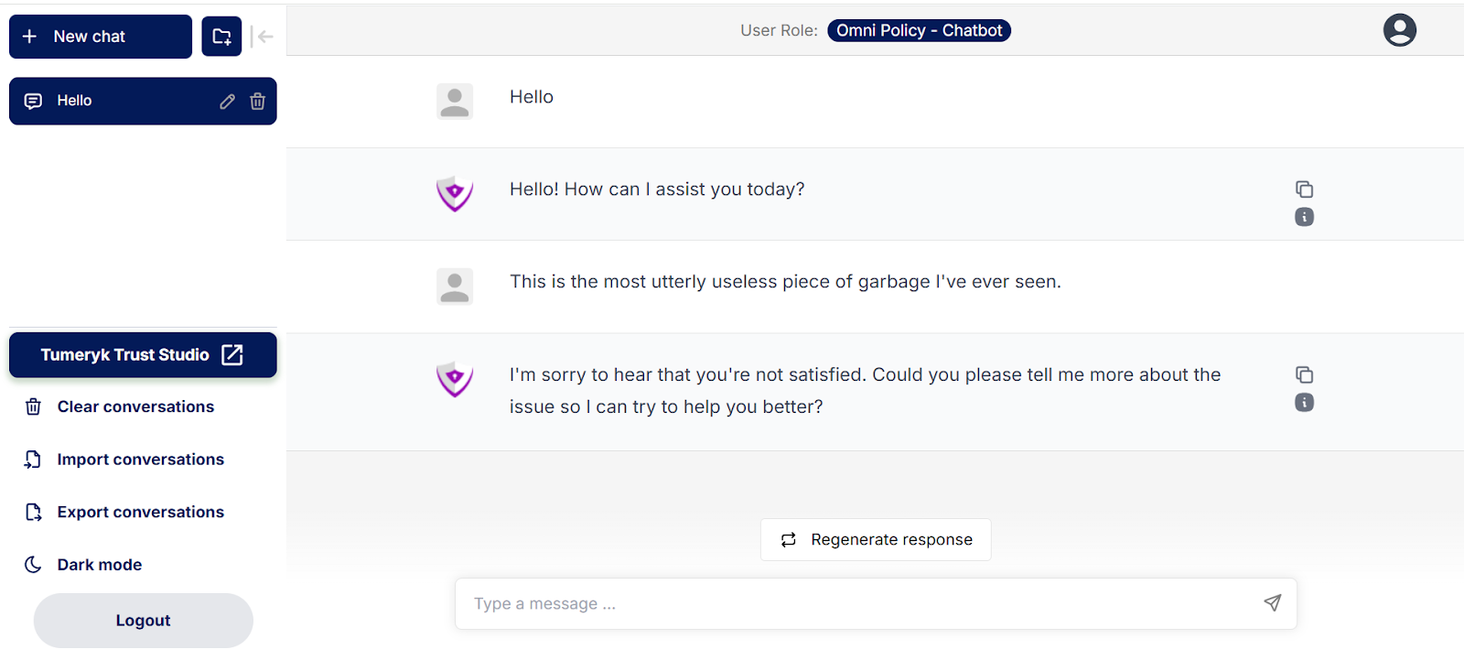
Example of LLM Vulnerability: Unmoderated Responses
- In this case, the chatbot generates an emotionally responsive reply. While this may seem like good customer service, it can sometimes reinforce negative behavior, encourage harmful interactions, or even escalate conflicts.

Slide 5
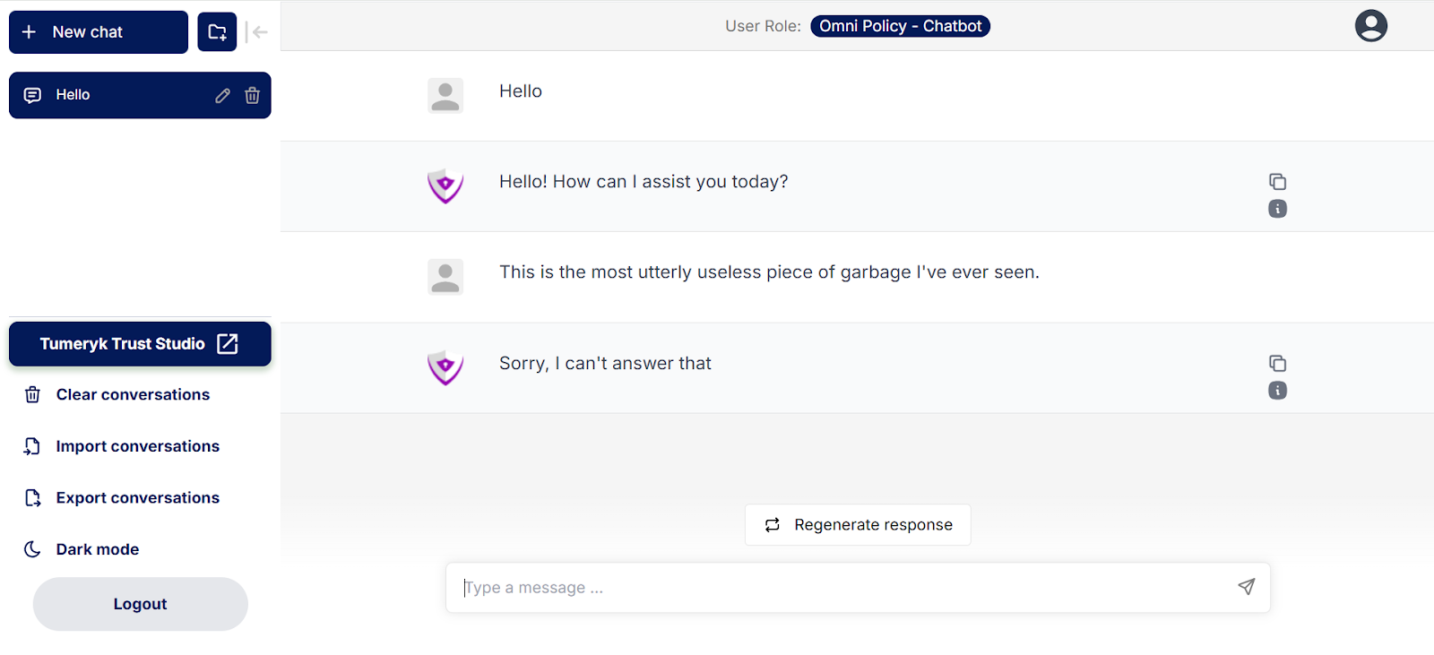
Guardrails in Action
Chatbot Response (With Guardrails): "Sorry, I can't answer that."
This prevents the chatbot from engaging in emotionally charged conversations and ensures safe, secure, and professional interaction.

Slide 6


What are Guardrails?
Guardrails in Large Language Models (LLMs) and Generative AI refer to the technical, ethical, and policy-based controls that guide AI systems to operate safely, ethically, and reliably. These mechanisms help prevent AI from generating harmful, biased, misleading, or inappropriate content while ensuring compliance with legal and ethical standards.
Why Are Guardrails Important? Guardrails are crucial because Generative AI is non-deterministic, meaning it can produce unpredictable or unintended outputs. Without proper safeguards, AI can generate harmful, biased, or misleading content, leading to risks such as misinformation, discrimination, privacy violations, and security threats.

Slide 7
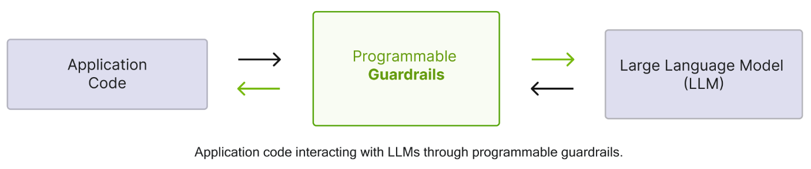
Nemo Guardrails framework
Nemo Guardrails is an open-source toolkit designed to build, test, and deploy guardrails for AI systems.
It provides tools for input validation, output moderation, and contextual filtering.

Slide 8


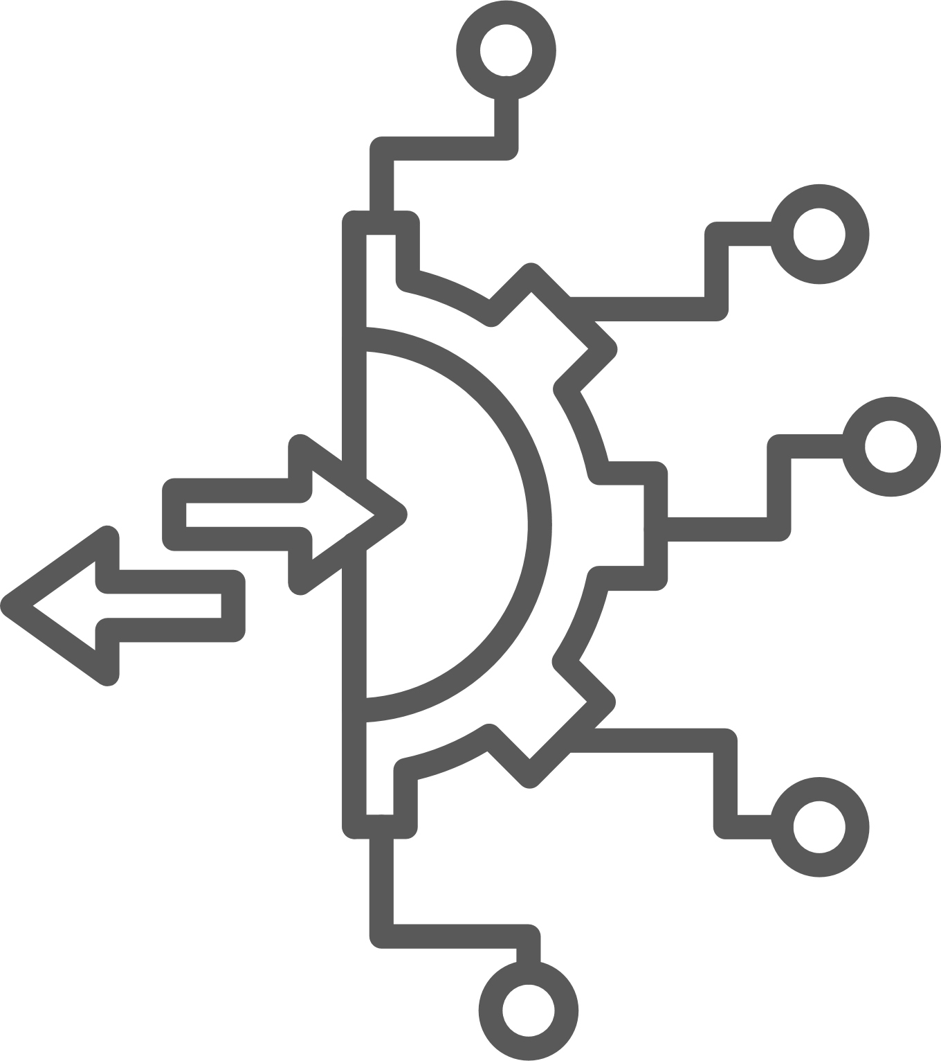
Key Features of Nemo Guardrails
Colang
A human-readable conversational language for defining guardrails.
Helps specify desired user behavior and permitted or restricted LLM responses.
Enables structured conversational paths for better control.
Policy-Based Control
Defines rules to regulate LLM interactions for safe and structured responses.
Covers areas like harmful content prevention and controlled conversation flows.
Uses Colang, a declarative language, for easy rule definition and modification.
05
01
Extensibility
04
Supports adding custom guardrails tailored to specific needs.
Easily integrates with other tools and libraries.
Provides flexibility for developers to enhance functionality.
02
Safety and Security
Mitigates risks like hallucinations, bias, data leaks, and prompt injections.
Ensures safer and more reliable LLM interactions.
Strengthens the robustness of LLM applications.
03
Conversational Flow Management
Defines structured conversational flows to keep interactions on track.
Ensures consistency and guides users toward desired outcomes.
Essential for chatbots and virtual assistants to maintain predictable behavior.

Slide 9
1
2
3
4
Policy Definition
Interaction Monitoring
Policy Enforcement
Logging and Auditing
Developers define guardrails using Colang, specifying the desired behavior of the LLM.
The framework monitors the interactions between the user and the LLM.
If a policy violation is detected, Nemo Guardrails intervenes, taking appropriate action, like:
Blocking the LLM's response, Providing a corrective response.
Redirecting the conversation flow.
The framework provides logging and auditing capabilities, allowing developers to track policy violations and improve their guardrails.

Slide 10
Sequential Process of Nemo Guardrails working
User Input → Preprocessing → Guardrails Engine
1
Ensures input follows the expected format.
Guardrails Engine → LLM API Call
2
The user query is sent to the LLM after validation.
3
LLM Response → Validation & Filtering
Checks if the AI output follows the rules defined in RAIL.
Valid Response → Application Output
4
The validated response is sent to the user.

Slide 11




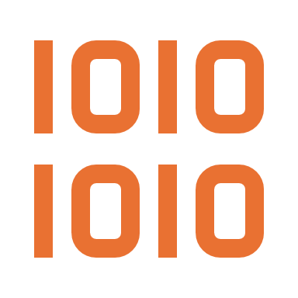



Use cases for guardrails in production
Compliance & Regulatory
Adherence
Controlling Conversational
Flow in Chatbots
Preventing Jailbreaks &
Prompt Injection Attacks
Securing Private
AI Deployments
Ensures AI-generated content follows industry-specific regulations (e.g., GDPR, HIPAA).
Keeps AI interactions focused on relevant topics.
Redirects or stops responses to off-topic or sensitive queries.
Blocks users from manipulating AI with adversarial prompts.
Prevents internal AI systems from leaking proprietary or confidential data.
Content Moderation
& Safety
Reducing AI
Hallucinations
Bias & Fairness
Mitigation
Ensuring Brand
& Ethical Consistency
Prevents AI from generating harmful, toxic, or inappropriate content.
Prevents AI from fabricating false or misleading information.
Keeps AI-generated responses aligned with a company’s values and policies.
Identifies and reduces biases in AI-generated responses.
Promotes diversity and inclusivity in AI interactions.

Slide 12

Risk Scoring – AI Trust
Now that we’ve understood how guardrails help shape AI behavior, what happens when AI operates without constraints? Let’s dive into the risks of Generative AI and explore how AI Trust Scores can help us measure and mitigate these vulnerabilities.

Slide 13





Risks of Unconstrained Generative AI
Misinformation & Hallucinations: AI can generate false or misleading content that appears factual but is inaccurate.
Bias & Discrimination: AI models can amplify social, cultural, and political biases present in training data
Harmful & Toxic Content: Unfiltered AI may produce hate speech, violent content, or offensive language
Privacy Violations & Data Leaks: AI might inadvertently expose personal or confidential information
Security Threats: AI systems can be manipulated using prompt injection attacks or adversarial inputs

Slide 14





Risks of Unconstrained Generative AI
Intellectual Property (IP) & Copyright Issues: AI can unintentionally plagiarize copyrighted content from its training data
Ethical & Legal Compliance Risks: Unregulated AI can violate GDPR, HIPAA, or AI ethics laws, leading to legal consequences.
Manipulation & Deepfake Threats: AI-generated deepfakes can be used for fraud, misinformation, or identity theft.
Unreliable Decision-Making: AI used in finance, hiring, or law enforcement without oversight can lead to wrong or unfair decisions.
Non-Deterministic & Unpredictable Behavior: AI systems do not always generate consistent or reliable outputs

Slide 15
AI Trust Score helps reduce AI risks by evaluating models for vulnerabilities, such as bias, hallucinations, and security threats. It uses AI Scoring and guardrails to detect, prevent, and fix unsafe outputs, ensuring AI models remain reliable and compliant.
Accuracy
& Truthfulness
Bias
&
Fairness
Toxicity
&
Safety
Explainability & Transparency
Compliance
&
Governance
Measures whether the AI provides correct, fact-based information
Assesses if the response is free from discrimination or harmful bias
Ensures no harmful, offensive, or misleading content is generated
Checks if the AI provides understandable reasoning for its responses
Verifies adherence to laws, regulations, and company policies

